Slide 1
Restaurant
Data Analysis

Slide 2
Introduction
Need For Restaurant Data Analysis -
The basic idea of analyzing the restaurants dataset is to get a fair idea about the factors affecting the establishment of different types of the restaurant at different places in Bangalore.
With each day new restaurants opening the industry hasn't been saturated yet and the demand is increasing day by day. In spite of increasing demand it ,however, has become difficult for new restaurants to compete with established restaurants.
Bangalore being an Economical Capital of India. Most of the people here are dependent mainly on the restaurant food as they don’t have time to cook for themselves.

Slide 3
Need For Machine Learning -
Data analysis has traditionally been characterized by the trial and error approach – one that becomes impossible to use when there are large and heterogeneous data sets in question
Traditional statistical solutions are more focused on static analysis that is limited to the analysis of samples that are frozen in time. Obviously enough, this could result in unreliable and inaccurate conclusions.
There is one crucial reason why data scientists need machine learning, and that is: ‘High-value predictions that can guide better decisions and smart actions in real time without human intervention’.
Machine learning is able to produce accurate results and analysis by developing efficient and fast algorithms and data-driven models for real-time processing of this data.

Slide 4
Literature Survey
A Machine Learning Approach to Suggest Ideal Geographical Location for New Restaurant Establishment
DOI: DOI: 10.1109/R10-HTC.2018.8629845
Conference: 2018 IEEE 6th Region 10 Humanitarian Technology Conference (R10-HTC)
Abstract - . In recent time, for choosing a preferred restaurant location and calculating the
estimated risk, people are now hiring professionals to do ground check and here the data scientists are coming into play as a bigshot. This research is focused on suggesting a suitable place for setting up a restaurant business based on the existing data from Yelp where 75 features have been extracted for supervised machine learning. Their model will also calculate the expected rating that a restaurant will get depending on the features the restaurant possesses. Several machine learning algorithms (Statistical Analysis, Kmeans algorithm) have been used and juxtaposed to nurture out the suitable one. As yelp’s review is authentic and it is maintained regularly, they have considered the rating of a business as the point of suggestion. they have also looked at thecomparative analysis of these algorithms and searched for an
algorithm that gives us the best result.

Slide 5
2. A Research Proposal: The Effects of Restaurant Environment on Consumer Behavior
Jin,. Qiuyu, "A Research Proposal: The Effects of Restaurant Environment on Consumer Behavior" (2015). MBA Student Scholarship36
.
Abstract
The purpose of the present study is to find out the effects of restaurant environment on consumer behavior. To obtain the primary data, the self-administered questionnaires will be distributed to patrons in selected restaurants as they are waiting for their checks or as they are getting ready to leave after meals. This method ensures that the patrons will give responses which can accurately reflect their evaluation of the dining experience. The questionnaire will measure participants’ perceptions of the restaurant environment and their behavioral intentions. Instrumentation In order to make sure most of the region’s restaurant consumers can read and understand the questionnaire, it will be designed in English version. The content of the questionnaire will be divided into four different parts. The first part will measure participants’ perceptions of the restaurant environment and atmospherics. It contains 10 attributes which reflect the dimensions of restaurant atmospherics. Furthermore, these attributes will be described as the statements that reflect patrons’ perceptions of the environment and atmospherics. Then, there will be a five-point Likert scale range from 1 (strongly disagree) to 5 (strongly agree) to be selected as their responses.

Slide 6
3. Restaurant setup business analysis using yelp dataset
Published in: 2017 International Conference on Advances in Computing, Communications and Informatics (ICACCI)
Abstract
In this paper, They address the issues associated with setting-up of a new restaurant business. To strategize a new restaurant business, they propose a restaurant business framework which comprises of 3 most important tasks, namely, high frequency attributes, most crowded day and location of the restaurant. First, they identify the features/attributes of the restaurants in which the customers are most interested in and provide those facilities and services to increase the profit. Next, they identify the day of the week when the restaurants are heavily crowded so that the best recipes and offers are made available on those days. Finally, since location has a profound effect on the success of a restaurant business, they consider location to be the most important to know the nearby restaurants and their facilities before coming up with a new restaurant business. The performance analysis of the proposed framework was carried out on the standard Yelp dataset. Thus, they found credit card to be the most preferred attribute, the most crowded day to be Monday and Davey to be the most desired ambience among the customers.

Slide 7
Problem Definition
The restaurant industry has an incredibly high turnover rate . Many new restaurants do not survive their first few years in business. In addition the restaurant business is flooded with various factors that impact success(location ,timing ,atmosphere ,food quality ,etc such that it can be extremely difficult to create a successful restaurant.
We hope to analyze zomato data to determine if there are certain factors that are most important for a successful restaurant. This study will be conducted individually for different cities , since geography plays an overwhelming role in food culture .
In theory, our studies will certain key points for success of the restaurant business. We also demonstrate how the new restaurant can be setup by identifying the nearest restaurants and the services.

Slide 8
Flowchart
1
01
Data Acquisition and Data Cleaning
02
Machine Learning Algorithms
03
Performance Evaluation
04
Data Visualization

Slide 9
Software Specification
Operating system : Windows
• Programming Language : Python
• Tool : Selenium API, foursquare API, Machine learning, Big data

Slide 10
Hardware Specification
System : Pentium Dual Core.
• Hard Disk : 120 GB.
• Input Devices : Keyboard, Mouse
• Ram : 4 GB

Slide 11
Algorithms
K-means
K-means algorithm is an iterative algorithm that tries to partition the dataset into K pre-defined distinct non-overlapping subgroups (clusters) where each data point belongs to only one group.
In this analysis we use Clustering on the basis of various attributes of the restaurant.
Steps in K-means Algorithm-
First we initialize k points, called means, randomly.
We categorize each item to its closest mean and we update the mean’s coordinates, which are the averages of the items categorized in that mean so far.
We repeat the process for a given number of iterations and at the end, we have our clusters.

Slide 12
Statistical Analysis
A statistical hypothesis is an assumption about a population which may or may not be true.
Hypothesis testing is a set of formal procedures used by statisticians to either accept or reject statistical hypotheses.
Pearson Correlation coefficient –
Correlation is a statistical term which in common usage refers to how close two variables are to having a linear relationship with each other.
P- Value -
All statistical tests produce a p-value and this is equal to the probability of obtaining the observed difference, or one more extreme, if the null hypothesis is true.
if the p-value is small the data support the alternative hypothesis.
If the p-value is large the data support the null hypothesis.
Null hypothesis, - represents a hypothesis of chance basis.
Alternative hypothesis, - represents a hypothesis of observations which are influenced by some non-random cause.

Slide 13
OLS Multiple regression
OLS or Ordinary Least Squares is a method in Linear Regression for estimating the unknown parameters by creating a model which will minimize the sum of the squared errors between the observed data and the predicted one.
y = b₁x₁ + b₂x₂ + … + b_{n}x_{n} + c.
y_{i} = β₀ + Σ_{j=1..p} β_{j}X_{ij}
The OLS method corresponds to minimizing the sum of square differences between the observed and predicted values.

Slide 14
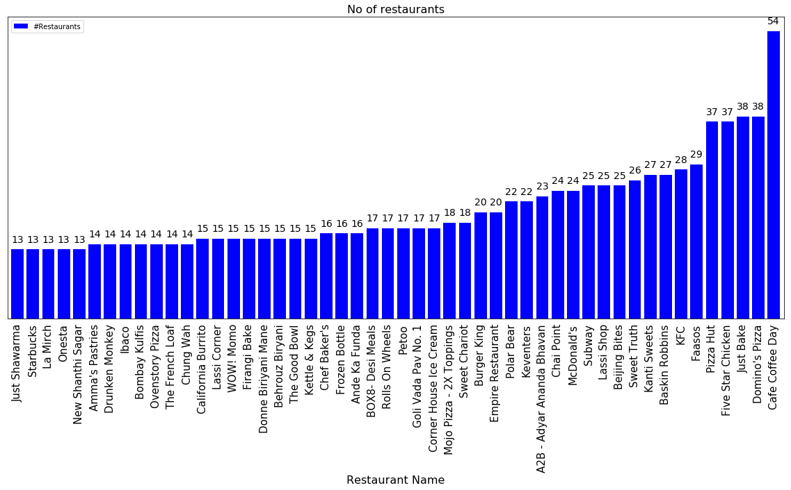
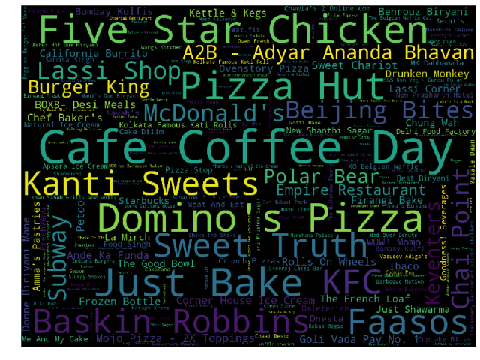
Number of food chains in Bengaluru

Slide 15
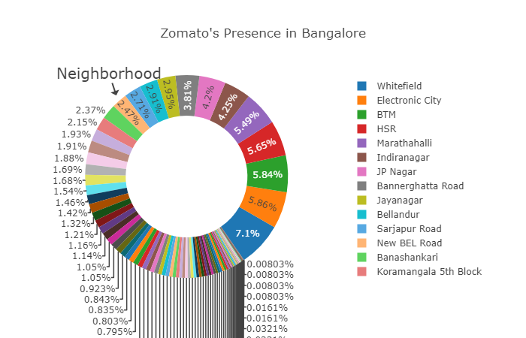
Infographics - Report Concept

Slide 16
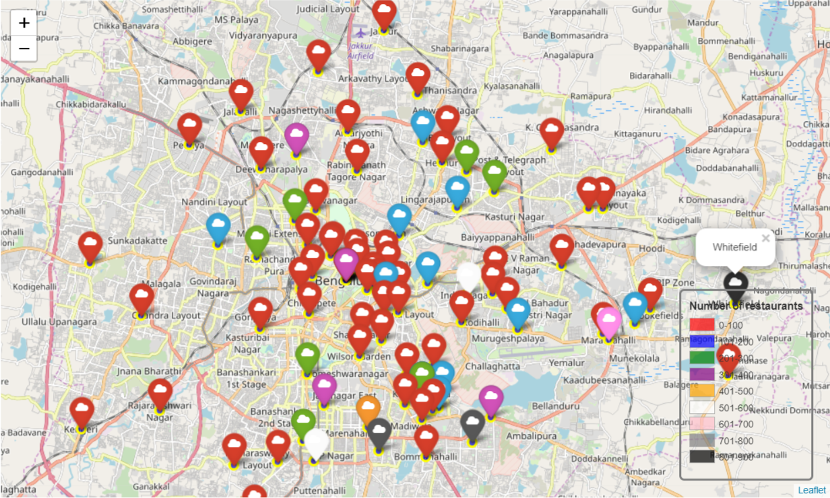
Top rated restaurants are also clustered around Central Bengaluru

Slide 17
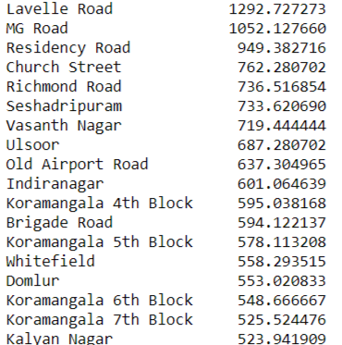
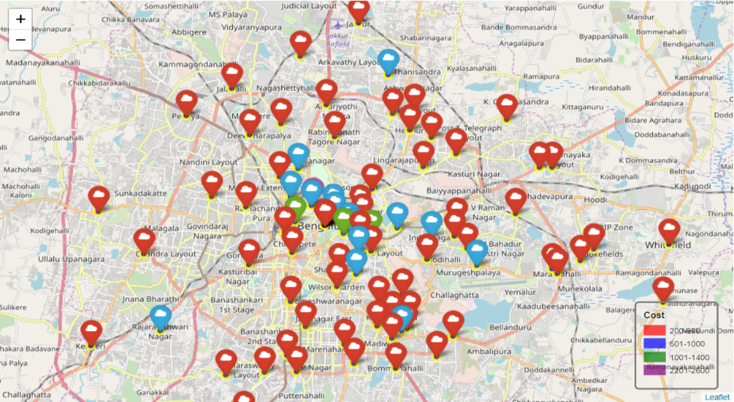
Approx cost of food by neighborhood
Cost of living in Lavelle Road is also quite high, even I can't afford the restaurants in lavelle road

Slide 18
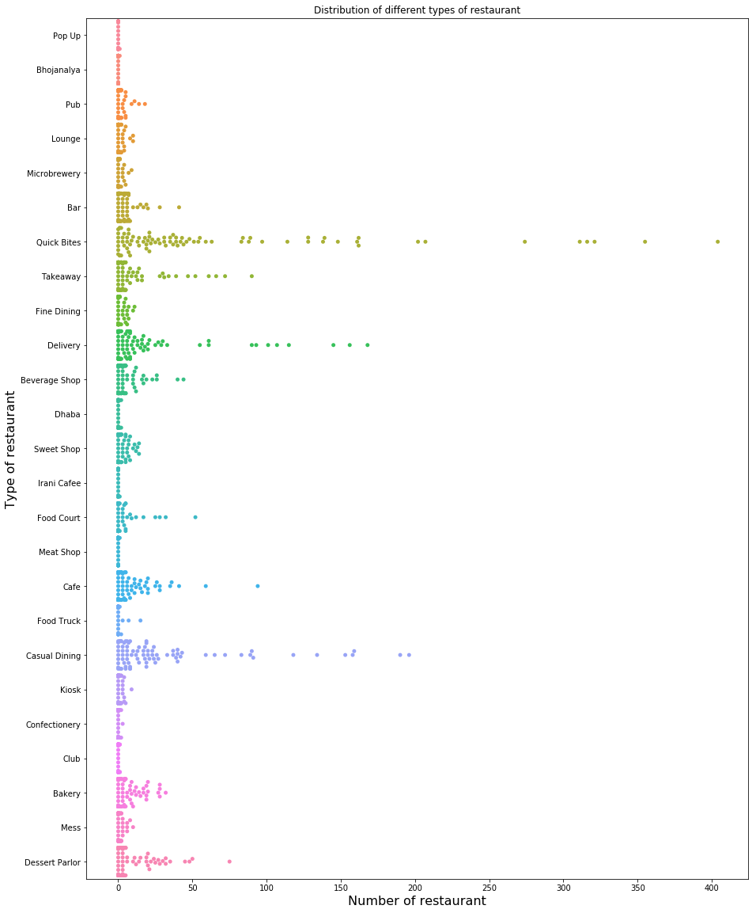
Quick Bites, Delivery, casual Dining
The population of Bangalore comprises mostly of people from 25-35 years of age. Hence delivery restaurant have to plan accordingly.

Slide 19
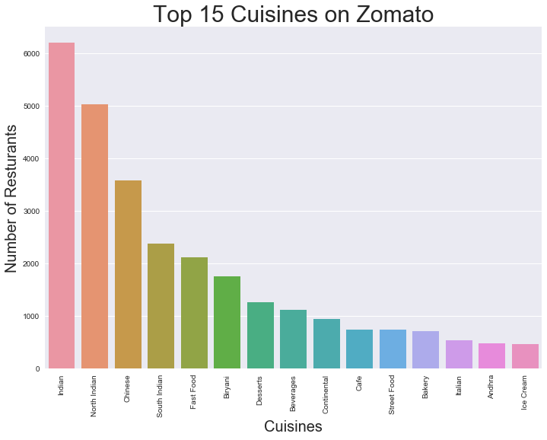
Regression models performance
Even though Bangalore is in South India but North Indian dishes are more famous here.

Slide 20
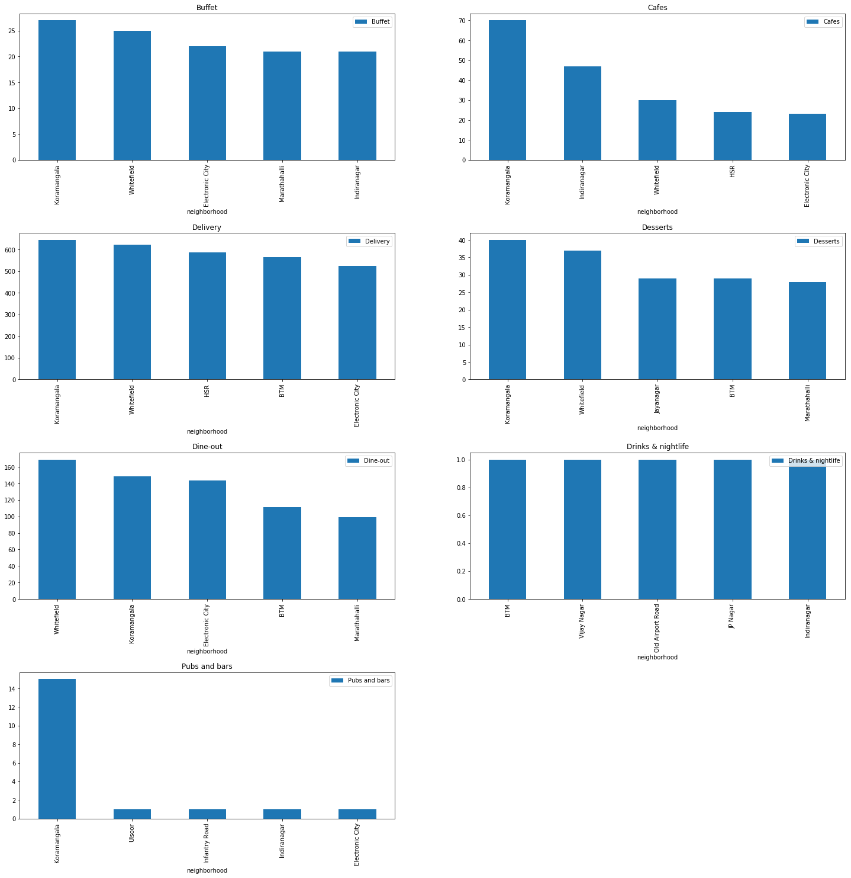
Top rated restaurants are also clustered around Central Bengaluru

Slide 21
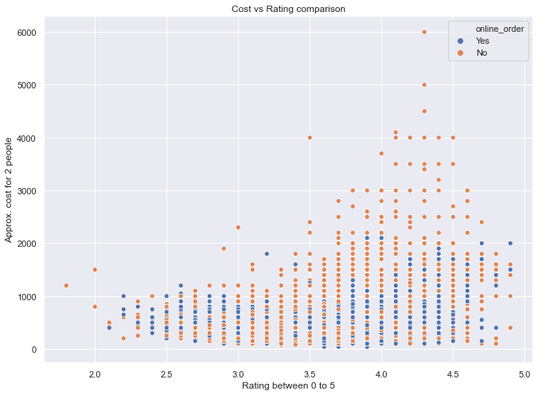
Cost vs Rating
Cost increase Rating increase

Slide 22
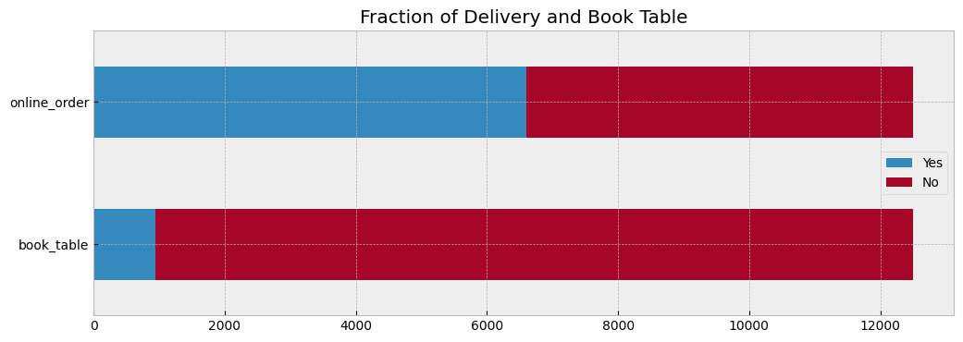
The restaurants that provide online Delivery and table booking option accross Bengaluru

Slide 23
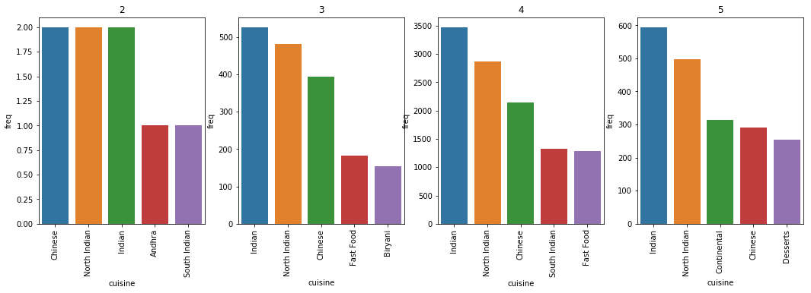
Foreign Cuisines are highly rated

Slide 24
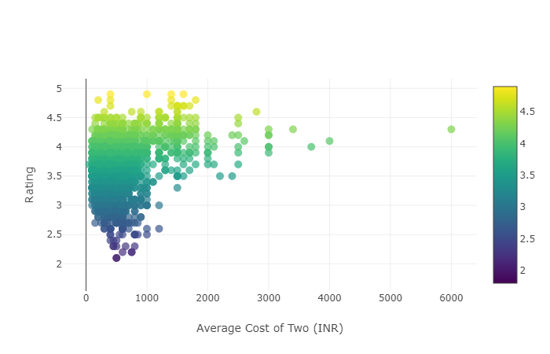
Statistical Analysis :Rating and cost
Pearson correlation. Null Hypothesis : There is no relationship between the rating and price of the restaurant Alternate Hypothesis : There is some relationship between the two.
P-value of: 3.59519e-228
Reject our NULL hypothesis. There is some relationship between the two

Slide 25
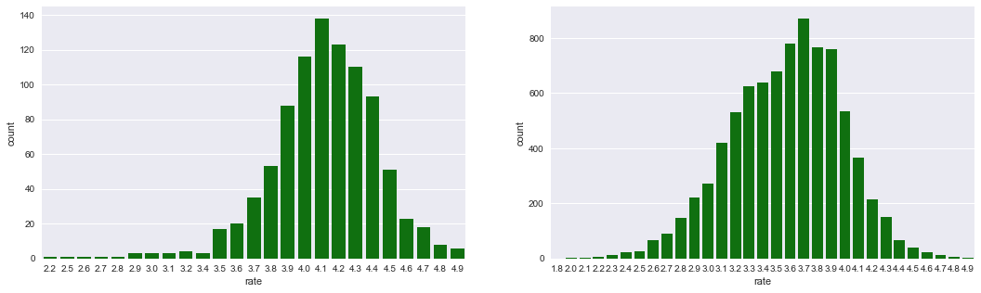
Restaurants that offer Table booking option were rated higher
Yes, Table book option restaurants are rated higher.

Slide 26
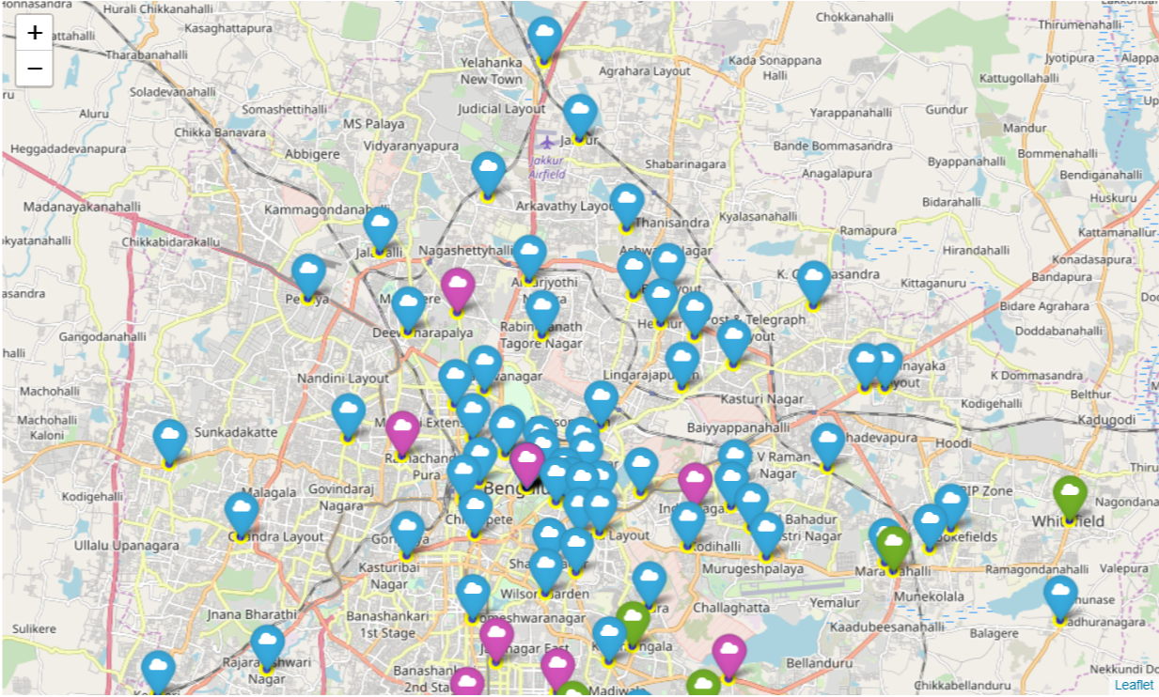
K-means Clustering based on Type of Restaurant
Cluster 1 or those marked in Blue are the places that are more famous for its Biryani, Chinese, Fast food and North Indian food.
Cluster 2 or those marked in Green are those places that are more famous for its South Indian, Indian, North Indian, Chinese as well as fast food.
Cluster 3 or those marked in Purple were those areas where Street Food, Chinese, Fast food were more popular or we can say more number of restaurants were present.

Slide 27
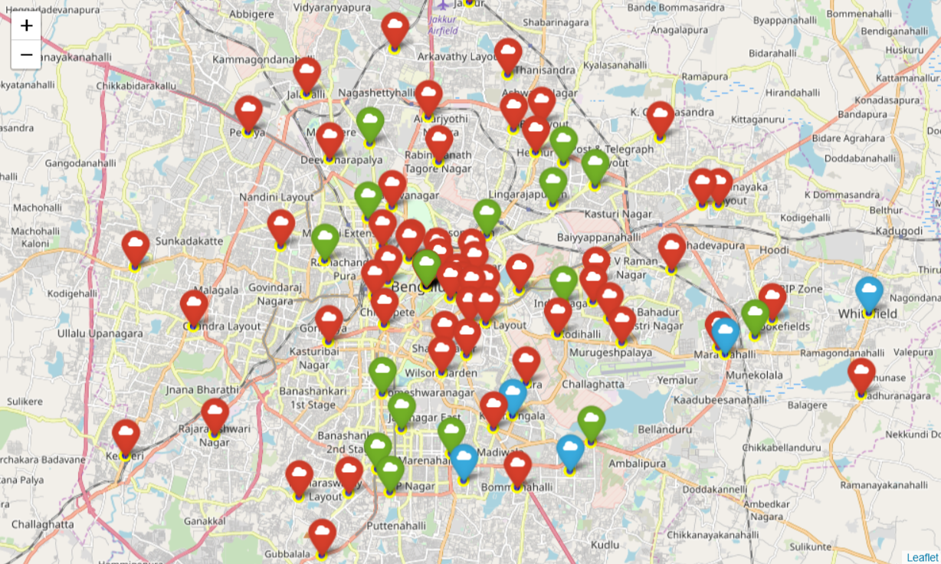
Clustering of neighbourhood based on Cuisines
Cluster 1 that are marked in red are generally residence(only) areas of bangalore. There aren't much nighlife, pubs, bars in those areas
Cluster 2 marked in Blue are the hubs of restaurant in Bangalore, After verifying it with the ground truth it was found that new foreign food chain starts its operation from these places only.
Cluster 3 marked in green contains most of the posche areas of Bengaluru, they contain both residence as well as costly restaurants of Bangalore.

Slide 28
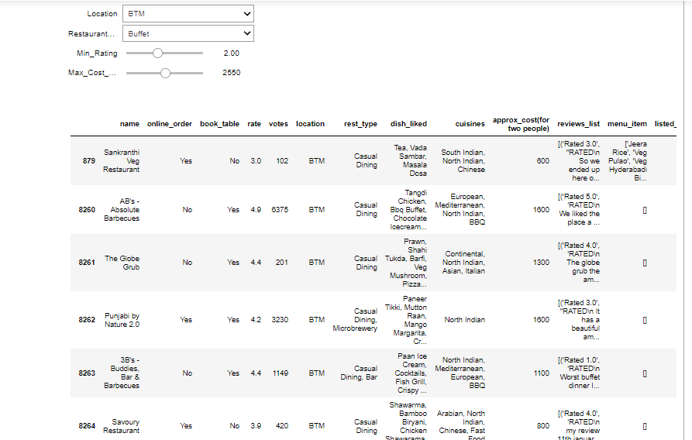
Dashboard to search for restaurant According To Their Name, location, rating, cost for two.

Slide 29
Conclusion
Quick service restaurants are a mainstay of the Indian food service market, and are growing fast. Fine dining is gaining prominence too. Both multi-cuisine and single-cuisine establishments have shown tremendous growth.
The model and the idea can be used in real life if I get the access to the ordering data of zomato.
Telling certainly about entire neighborhood which is really large is not possible. But the taste of a locality can be found out by their ordering pattern and the type of restaurant it houses.
These pattern can be mined from the data which is seen in the real life too. Thanks to the diversity of India. The data can also be used to find out the popular food, type of people, residency area etc to help new restaurants take better data driven decisions.

Slide 30
`
Thank You

